Slide 1
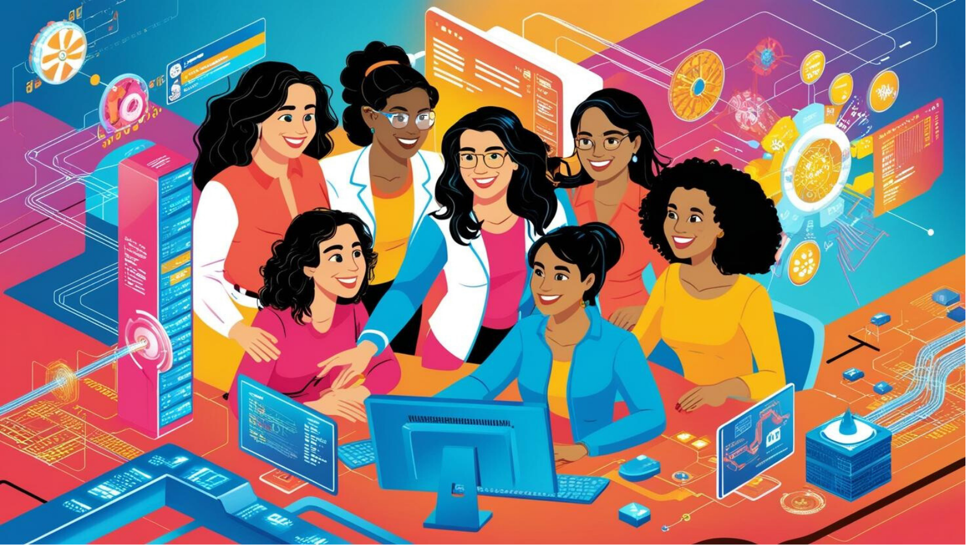

Supercomputing in Earth and Environmental Sciences
Renée Hall
Sian Kou-Giesbrecht
March 6, 2025

Slide 2
Dalhousie University operates in the unceded territories of the Mi’kmaw, Wolastoqey, and Peskotomuhkati Peoples. These sovereign nations hold inherent rights as the original peoples of these lands, and we each carry collective obligations under the Peace and Friendship Treaties. Section 35 of the Constitution Act, 1982 recognizes and affirms Aboriginal and Treaty rights in Canada.
Notes:
Mi’kmaq: MEEG EM ACH
Wolastoqoey: WOO LUSS TOOK OH WAY
Peskotomuhkati: BESS GO DUE MO GUDD EE

Slide 3
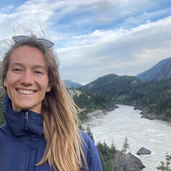
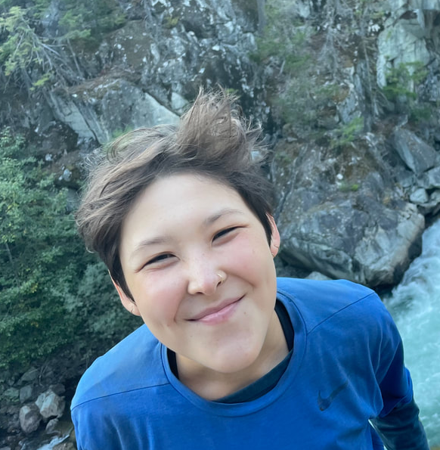
Welcome!
Renée Hall
PhD Student, Earth and Environmental Sciences
Impact of wildfire on nitrogen and carbon cycling
Likes: House plants
Dislikes: Phone calls with bad reception
Dr. Sian Kou-Giesbrecht
Assistant Professor, Earth and Environmental Sciences
Nitrogen cycling in terrestrial ecosystems and how it is represented in terrestrial biosphere models and Earth System Models
Likes: Dog (Goji)
Dislikes: Moldy Grapes
Notes:
Turn to the person on your left and tell them what you ate for breakfast today.
Turn to the person on your right and tell them what colour socks you’re wearing.

Slide 4

About this Workshop
This workshop is made possible by the Digital Research Alliance of Canada’s Equity Diversity Inclusion and Accessibility (EDIA) Champions program.
A big thank you to Ross Dickson at ACENET.
Notes:
This opportunity aims to increase awareness and uptake of the Alliance’s digital research infrastructure (DRI) by equity-seeking groups.

Slide 5
Goals of this workshop
Introduce the Digital Research Alliance of Canada (DRAC) and digital research infrastructure (DRI)
Introduce terrestrial biosphere models (TBMs) and CLASSIC
Hands-on activities with the terminal, DRAC’s DRI, and CLASSIC

Slide 6
Schedule
Digital Research Alliance of Canada (DRAC), Digital Research Infrastructure (DRI), Advanced Research Computing (ARC)
Terrestrial Biosphere Models (TBMs)
CLASSIC
Break (10 minutes)
Terminal
Terminal Activity
Connecting to DRAC
Running CLASSIC
Break & Dinner (30 minutes)
Model Outputs
Notes:
Dinner @ 5:30pm

Slide 7
Digital Research Alliance of Canada (DRAC)
Non-profit organization funded by the Government of Canada
Provide all Canadian scientists and scholars with the digital tools they need to conduct the world-leading research that supports innovation in Canada
Integrate, champion and fund the infrastructure and activities required digital research infrastructure (DRI)

Slide 8
What is Digital Research Infrastructure?

Slide 9
What is Digital Research Infrastructure?
data management (DM)
research software (RS)
advanced research computing (ARC)

Slide 10
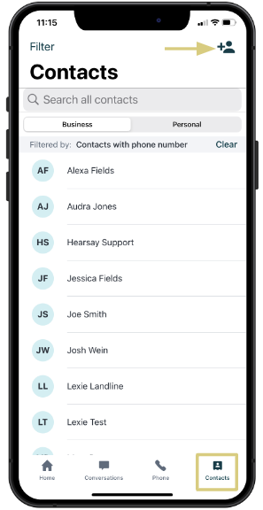
What is Digital Research Infrastructure?
data management (DM)
research software (RS)
advanced research computing (ARC)
Notes:
Phone analogy for DRI. Phone represents a tool which helps keep contacts organized, easy to access and use.
DM: In phone analogy, this is the actual storage and organization of contact info. The contacts app makes it easy to find and access our contact information.
RS: The phone software or operating system, which lets us use the data to make phone calls, send text messages etc.
ARC: The physical hardware that makes it possible for us to use our phones.

Slide 11

What is Digital Research Infrastructure?
data management (DM)
research software (RS)
advanced research computing (ARC)
Notes:
Phone analogy for DRI. Phone represents a tool which helps keep contacts organized, easy to access and use.
DM: In phone analogy, this is the actual storage and organization of contact info. The contacts app makes it easy to find and access our contact information.
RS: The phone software or operating system, which lets us use the data to make phone calls, send text messages etc.
ARC: The physical hardware that makes it possible for us to use our phones.

Slide 12
What is Digital Research Infrastructure?
data management (DM)
research software (RS)
advanced research computing (ARC)
Notes:
Phone analogy for DRI. Phone represents a tool which helps keep contacts organized, easy to access and use.
DM: In phone analogy, this is the actual storage and organization of contact info. The contacts app makes it easy to find and access our contact information.
RS: The phone software or operating system, which lets us use the data to make phone calls, send text messages etc.
ARC: The physical hardware that makes it possible for us to use our phones.

Slide 13
What is Digital Research Infrastructure?
data management (DM), allowing researchers to find and access data
research software (RS)
advanced research computing (ARC)
Notes:
Phone analogy for DRI. Phone represents a tool which helps keep contacts organized, easy to access and use.
DM: In phone analogy, this is the actual storage and organization of contact info. The contacts app makes it easy to find and access our contact information.
RS: The phone software or operating system, which lets us use the data to make phone calls, send text messages etc.
ARC: The physical hardware that makes it possible for us to use our phones.

Slide 14
What is Digital Research Infrastructure?
data management (DM), allowing researchers to find and access data
research software (RS), enabling researchers to access and use data
advanced research computing (ARC)
Notes:
Phone analogy for DRI. Phone represents a tool which helps keep contacts organized, easy to access and use.
DM: In phone analogy, this is the actual storage and organization of contact info. The contacts app makes it easy to find and access our contact information.
RS: The phone software or operating system, which lets us use the data to make phone calls, send text messages etc.
ARC: The physical hardware that makes it possible for us to use our phones.

Slide 15
What is Digital Research Infrastructure?
data management (DM), allowing researchers to find and access data
research software (RS), enabling researchers to access and use data
advanced research computing (ARC), involving super computers that allow researchers to analyze massive amounts of data
Notes:
Phone analogy for DRI. Phone represents a tool which helps keep contacts organized, easy to access and use.
DM: In phone analogy, this is the actual storage and organization of contact info. The contacts app makes it easy to find and access our contact information.
RS: The phone software or operating system, which lets us use the data to make phone calls, send text messages etc.
ARC: The physical hardware that makes it possible for us to use our phones.

Slide 16
Advanced Research Computing (ARC)
Research computing: Whenever you’re doing research that depends on a computer.
Notes:
What is the difference between regular computing and advanced research computing?

Slide 17
Advanced Research Computing (ARC)
Advanced Research Computing: Whenever your own computer no longer suffices.
Research computing: Whenever you’re doing research that depends on a computer.
Notes:
What is the difference between regular computing and advanced research computing?

Slide 18
Advanced Research Computing (ARC)
Supercomputing: When the computer that suffices is a large, shared, custom system or cluster
Advanced Research Computing: Whenever your own computer no longer suffices.
Research computing: Whenever you’re doing research that depends on a computer.
Notes:
What is the difference between regular computing and advanced research computing?

Slide 19
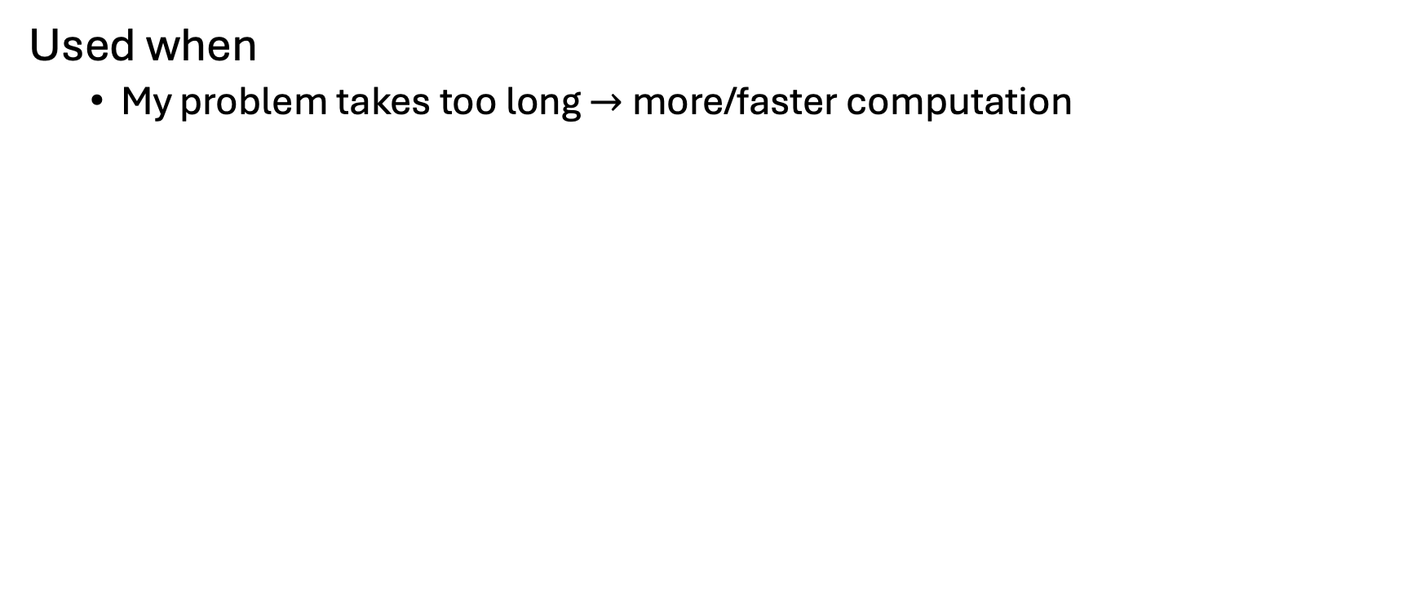
ARC Examples
Used when
My problem takes too long $→$ more/faster computation

Slide 20
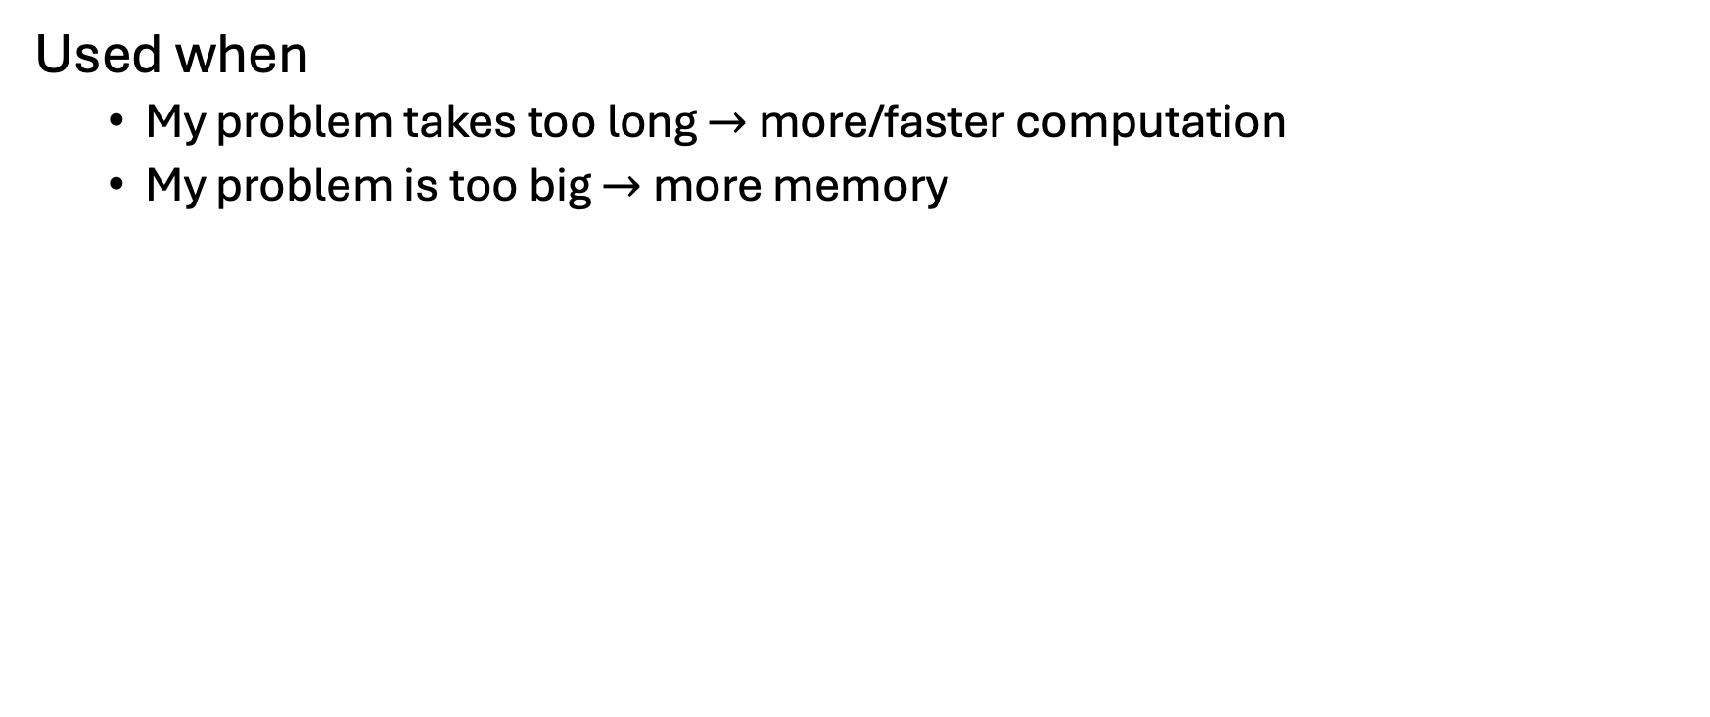
ARC Examples
Used when
My problem takes too long $→$ more/faster computation
My problem is too big $→$ more memory

Slide 21
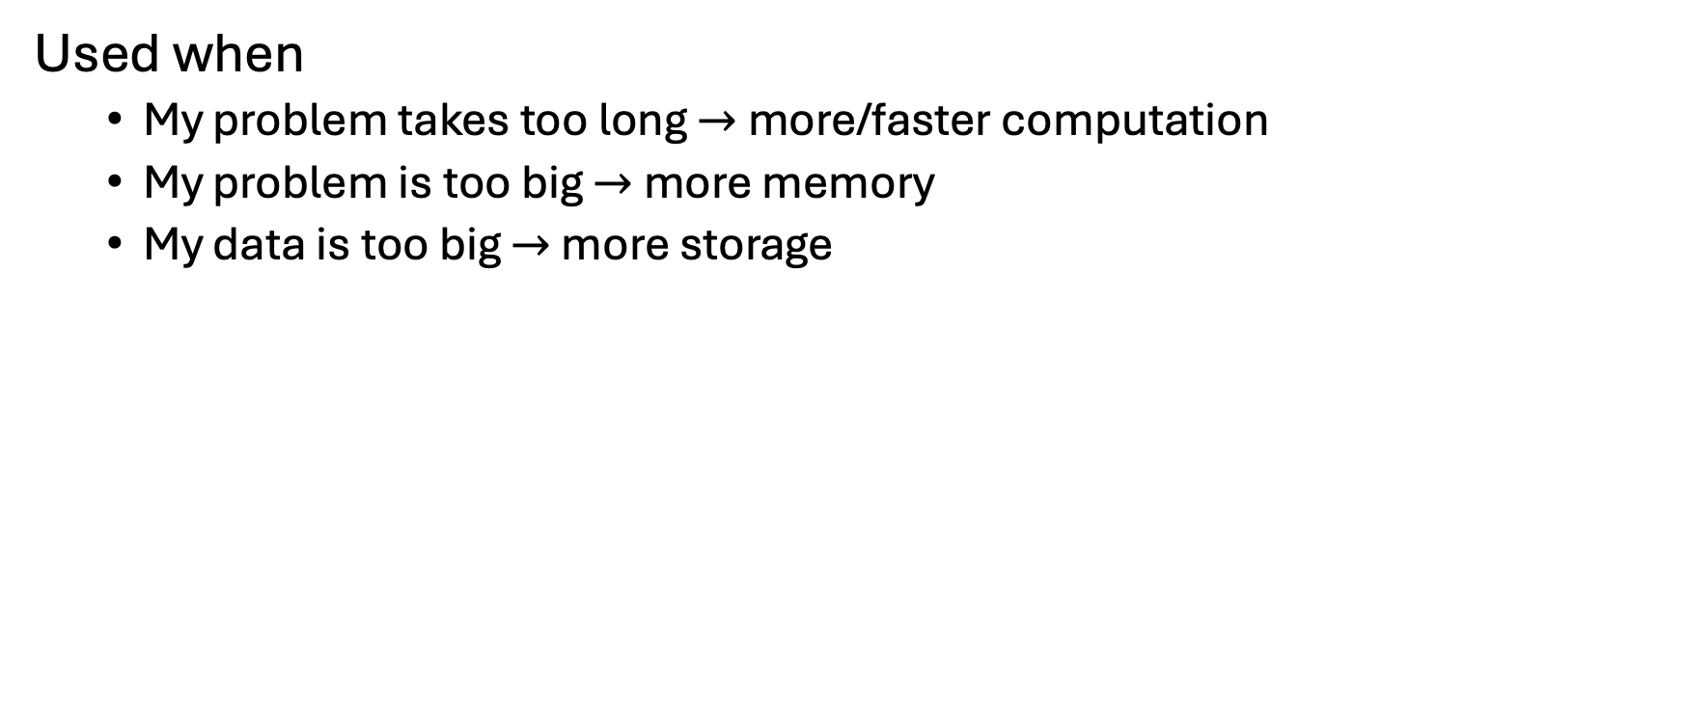
ARC Examples
Used when
My problem takes too long $→$ more/faster computation
My problem is too big $→$ more memory
My data is too big $→$ more storage

Slide 22
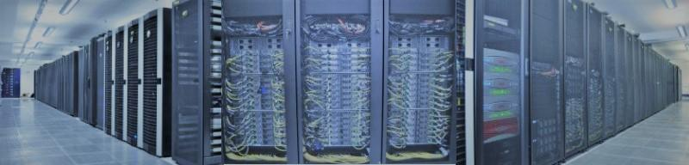
Advanced Research Computing (ARC)
advanced research computing (ARC), involving super computers that allow researchers to analyze massive amounts of data
Notes:
Clusters
Takes powerful standalone computer (node)
Each node has multiple cores that can access the same memory
Links them together through a network

Slide 23
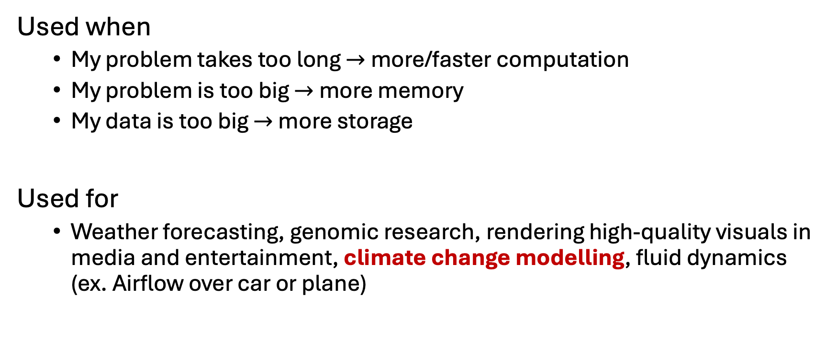
ARC Examples
Used when
My problem takes too long $→$ more/faster computation
My problem is too big $→$ more memory
My data is too big $→$ more storage
Used for
Weather forecasting, genomic research, rendering high-quality visuals in media and entertainment, climate change modelling, fluid dynamics (ex. Airflow over car or plane)
Notes:
weather forecasting, drug discovery, financial modeling, complex simulations in engineering, genomic research, climate change modeling, designing new materials, rendering high-quality visuals in media and entertainment, analyzing large datasets in scientific research, and optimizing complex systems in manufacturing

Slide 24
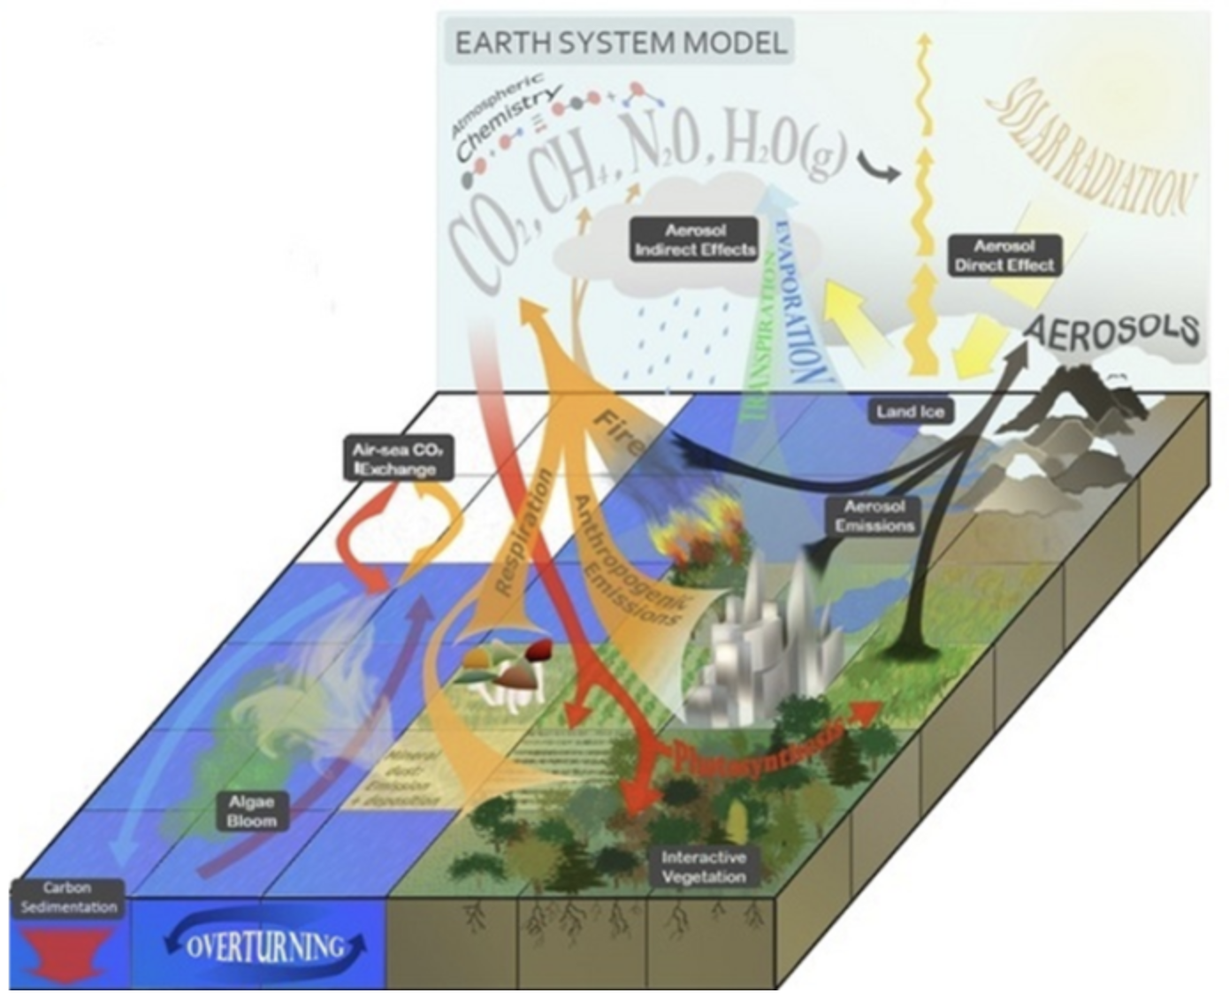
Terrestrial Biosphere Models (TBMs)
The land component of Earth System Models (ESMs)
climateurope
Notes:
Define ESM

Slide 25
Terrestrial Biosphere Models (TBMs)
The land component of Earth System Models (ESMs)
climateurope

Slide 26
Terrestrial Biosphere Models (TBMs)
The land component of Earth System Models (ESMs)
Used to understand and predict terrestrial biosphere responds to environmental changes
climateurope
Notes:
Explore environmental scenarios
Assess ecosystem vulnerabilities
Support informed decision-making for climate mitigation and adaptation

Slide 27
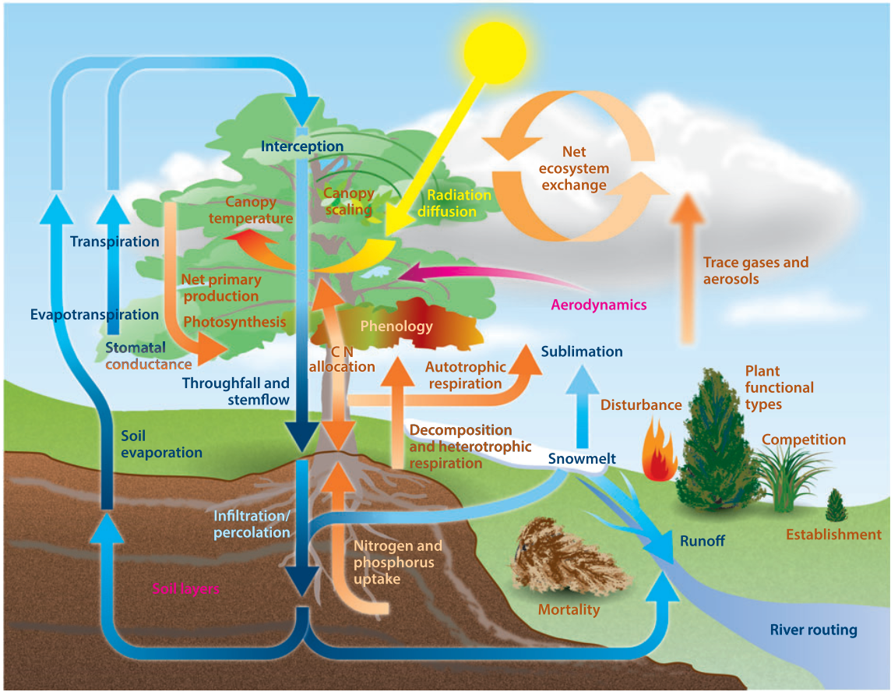
Terrestrial Biosphere Models (TBMs)
System of coupled mathematical models representing ecosystem processes
Fisher et al., 2014
Notes:
Define TBM

Slide 28

Terrestrial Biosphere Models (TBMs)
System of coupled mathematical models representing ecosystem processes
$$\frac{dB}{dt}=B(g\left(A_{N},A_{P}\right)−\left(μ+θ_{μ}F\right))$$
Menge et al., 2012
Fisher et al., 2014

Slide 29
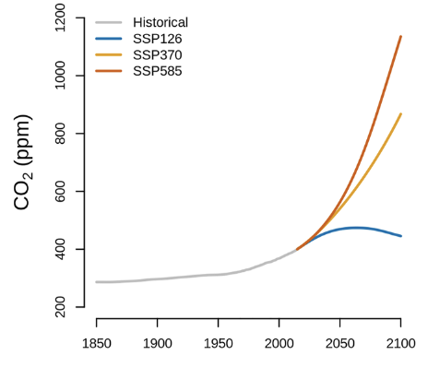
TBMs
Forcing data
Initial conditions
Meteorology
Land cover
CO₂ concentration
Soil type
Subsequent changes
Figure modified from Kou‐Giesbrecht and Arora, 2023
Notes:
What the model needs to run

Slide 30











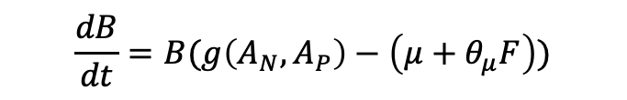
TBMs
System of coupled mathematical models representing ecosystem processes
Geophysical
$$\frac{dB}{dt}=B(g\left(A_{N},A_{P}\right)−\left(μ+θ_{μ}F\right))$$
Biological
Chemical

Slide 31
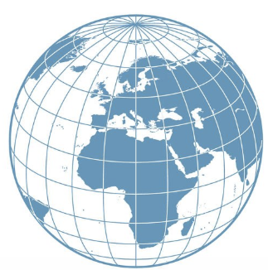
TBMs
System of coupled mathematical models representing ecosystem processes
Geophysical
$$\frac{dB}{dt}=B(g\left(A_{N},A_{P}\right)−\left(μ+θ_{μ}F\right))$$
Biological
Chemical
Notes:
Explain how TBM run each mathematical process representation for each grid cell and time step

Slide 32
TBMs
System of coupled mathematical models representing ecosystem processes
Iterative over:
Gridded domain
Notes:
Explain how TBM run each mathematical process representation for each grid cell and time step

Slide 33
TBMs
System of coupled mathematical models representing ecosystem processes
Iterative over:
Gridded domain
Time-step
Year 1
Year 2
Year 3
…
Final Year
Notes:
Explain how TBM run each mathematical process representation for each grid cell and time step

Slide 34
TBMs
System of coupled mathematical models representing ecosystem processes
Iterative over:
Gridded domain
Time-step
Year 1
Year 2
Year 3
…
Final Year
Notes:
Explain how TBM run each mathematical process representation for each grid cell and time step

Slide 35
TBMs
System of coupled mathematical models representing ecosystem processes
Iterative over:
Gridded domain
Time-step
Year 1
Year 2
Year 3
…
Final Year
Notes:
Explain how TBM run each mathematical process representation for each grid cell and time step

Slide 36
TBMs
System of coupled mathematical models representing ecosystem processes
Iterative over:
Gridded domain
Time-step
Year 1
Year 2
Year 3
…
Final Year
Notes:
Explain how TBM run each mathematical process representation for each grid cell and time step

Slide 37
TBMs
System of coupled mathematical models representing ecosystem processes
Iterative over:
Gridded domain
Time-step
Year 1
Year 2
Year 3
…
Final Year
Notes:
Explain how TBM run each mathematical process representation for each grid cell and time step

Slide 38
TBMs
System of coupled mathematical models representing ecosystem processes
Iterative over:
Gridded domain
Time-step
Year 1
Year 2
Year 3
…
Final Year
Notes:
Explain how TBM run each mathematical process representation for each grid cell and time step

Slide 39
TBMs
System of coupled mathematical models representing ecosystem processes
Iterative over:
Gridded domain
Time-step
Year 1
Year 2
Year 3
…
Final Year
Notes:
Explain how TBM run each mathematical process representation for each grid cell and time step

Slide 40
CLASSIC
The Canadian Land Surface Scheme Including Biogeochemical Cycles (CLASSIC)
The land surface component of the Canadian Earth System Model (CanESM)
Developed and maintained by Environment and Climate Change Canada

Slide 41
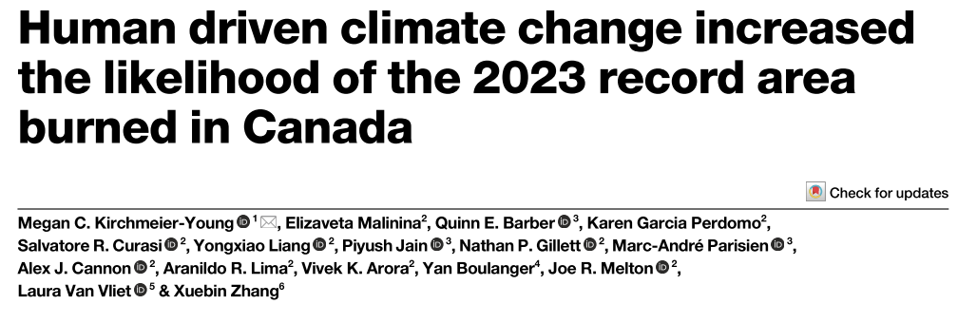
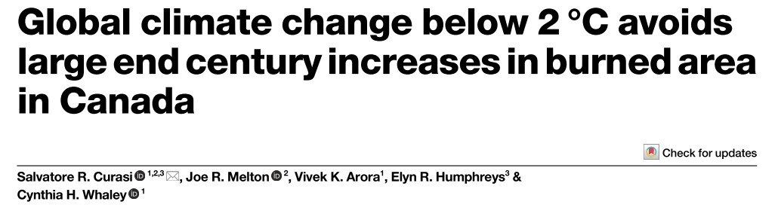
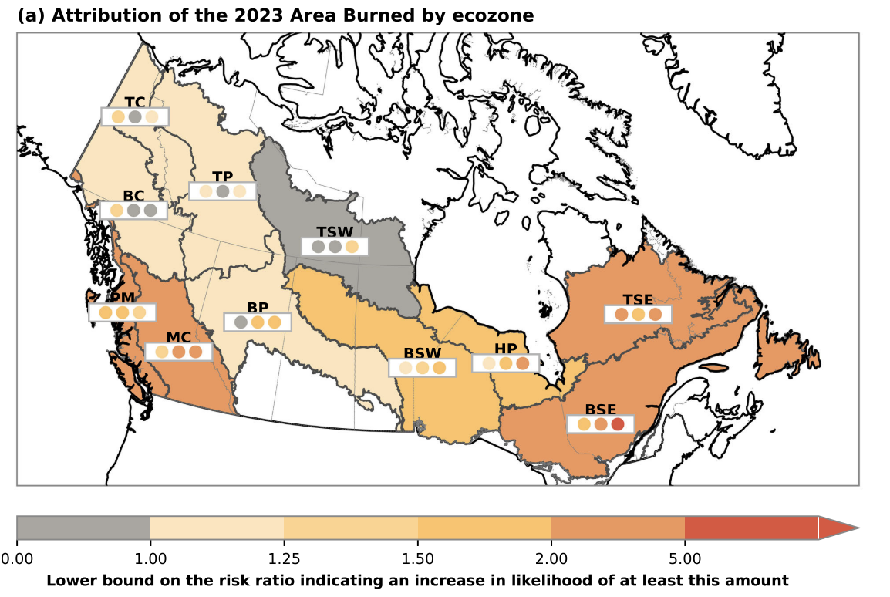
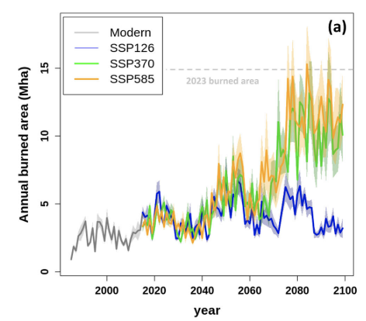
CLASSIC
Notes:
Example use case for CLASSIC

Slide 42
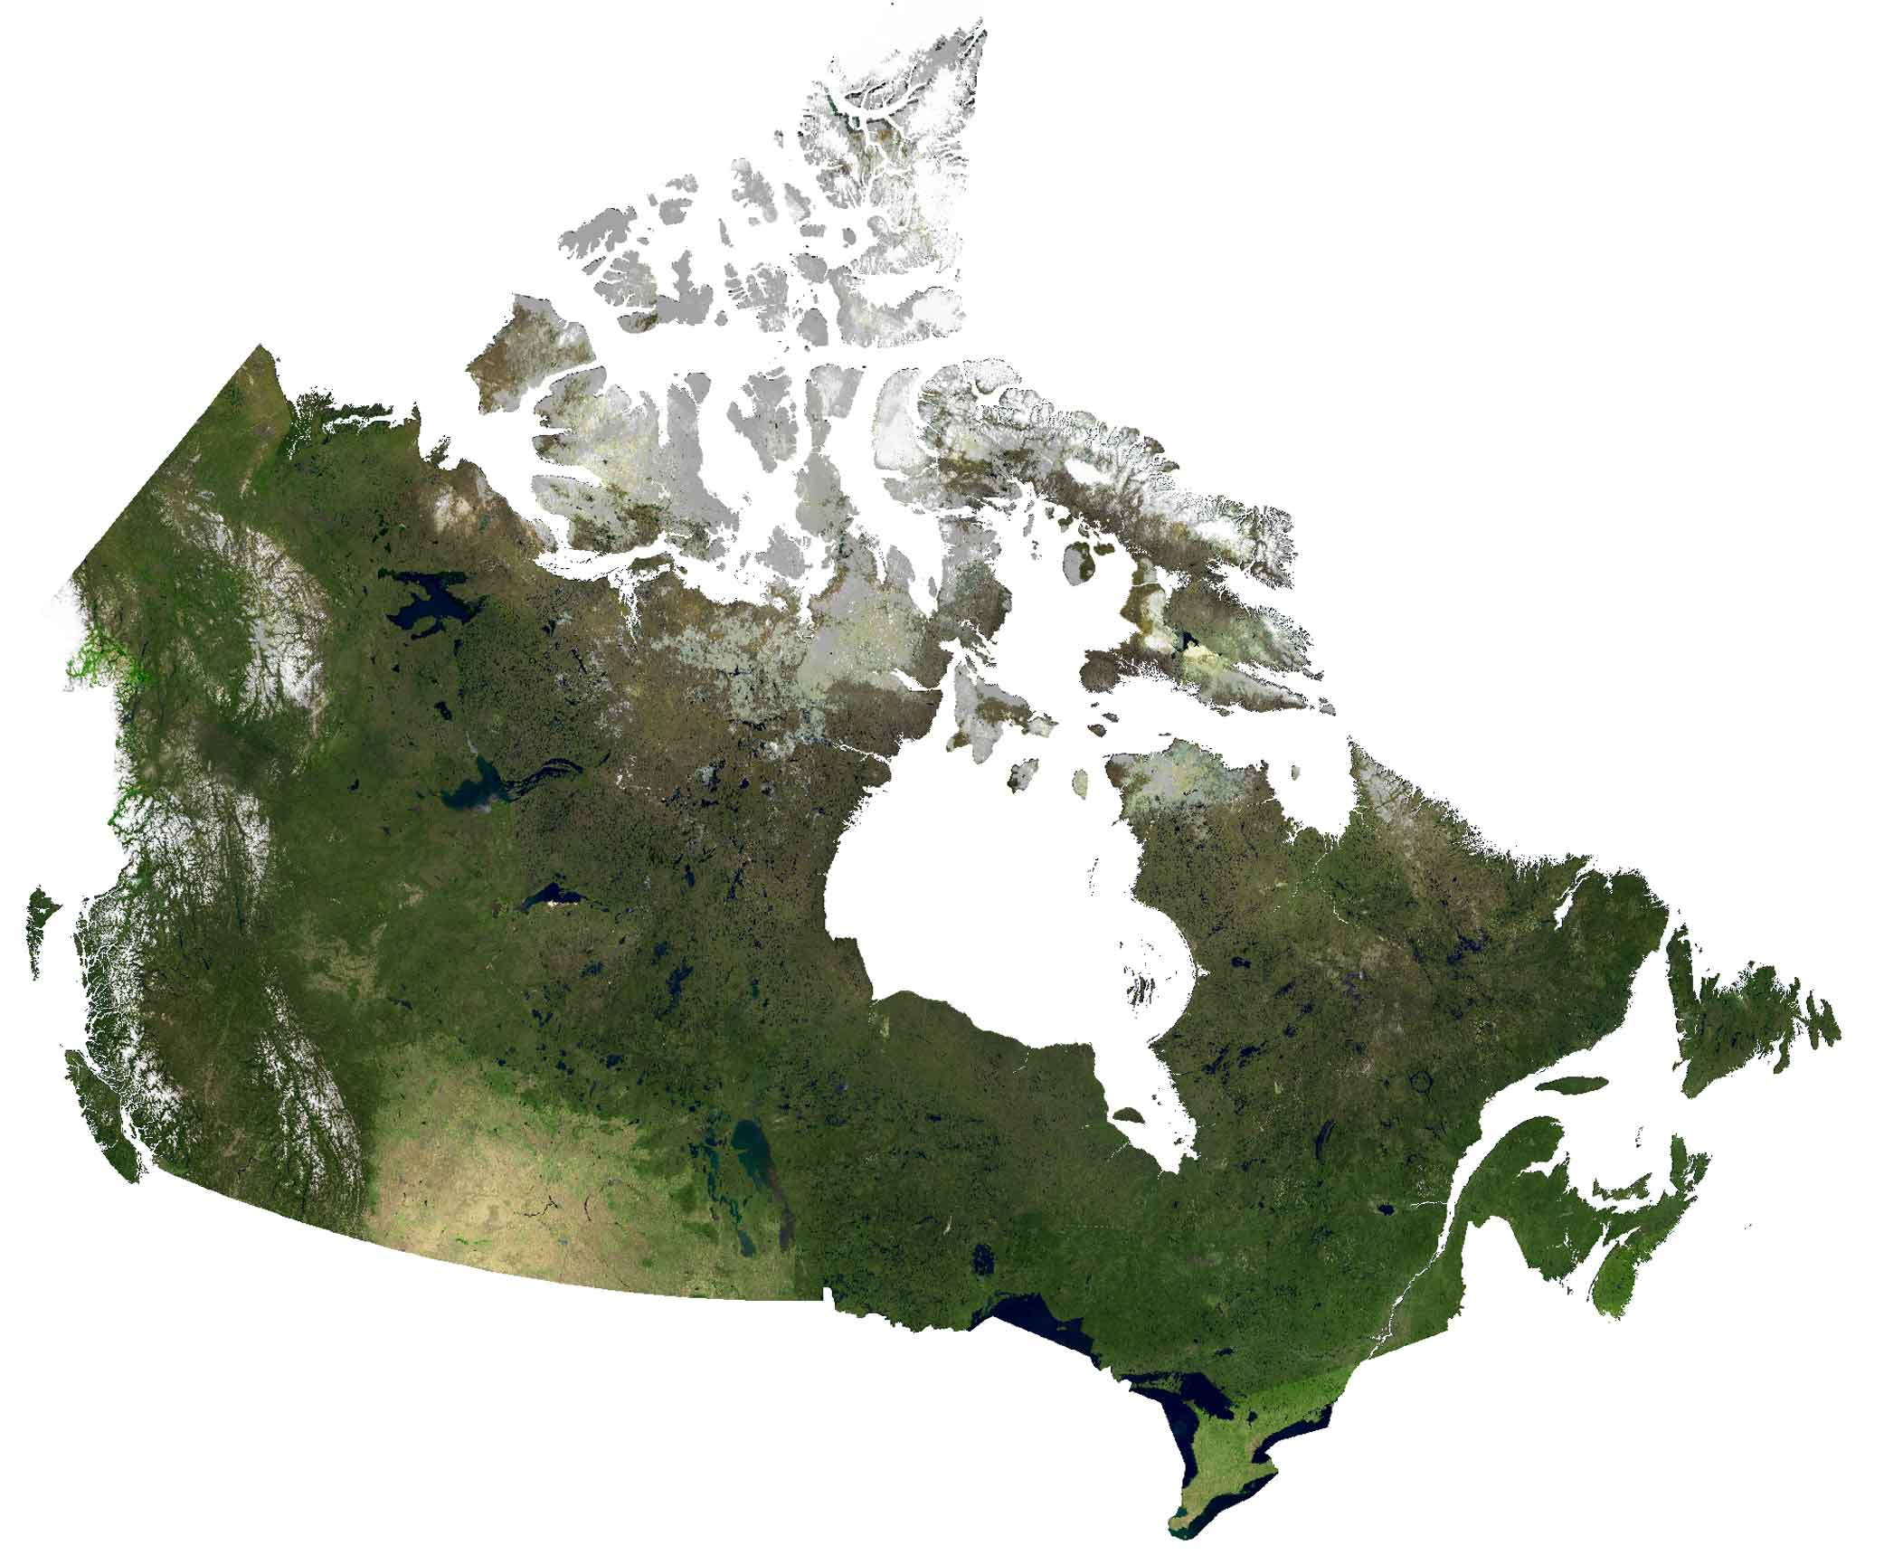

What we’ll do today
Run a CLASSIC simulation for a case study site on a DRAC high performance computer (HPC)
GISGeography
Notes:
Eastern Ontario

Slide 43
What we’ll do today
Run a CLASSIC simulation for a case study site on a DRAC high performance computer (HPC)
Boreal Mixedwood Forest
Selectively logged in 1930’s
Avg. forest age 85 to 90 years old
GISGeography
Notes:
Eastern Ontario

Slide 44
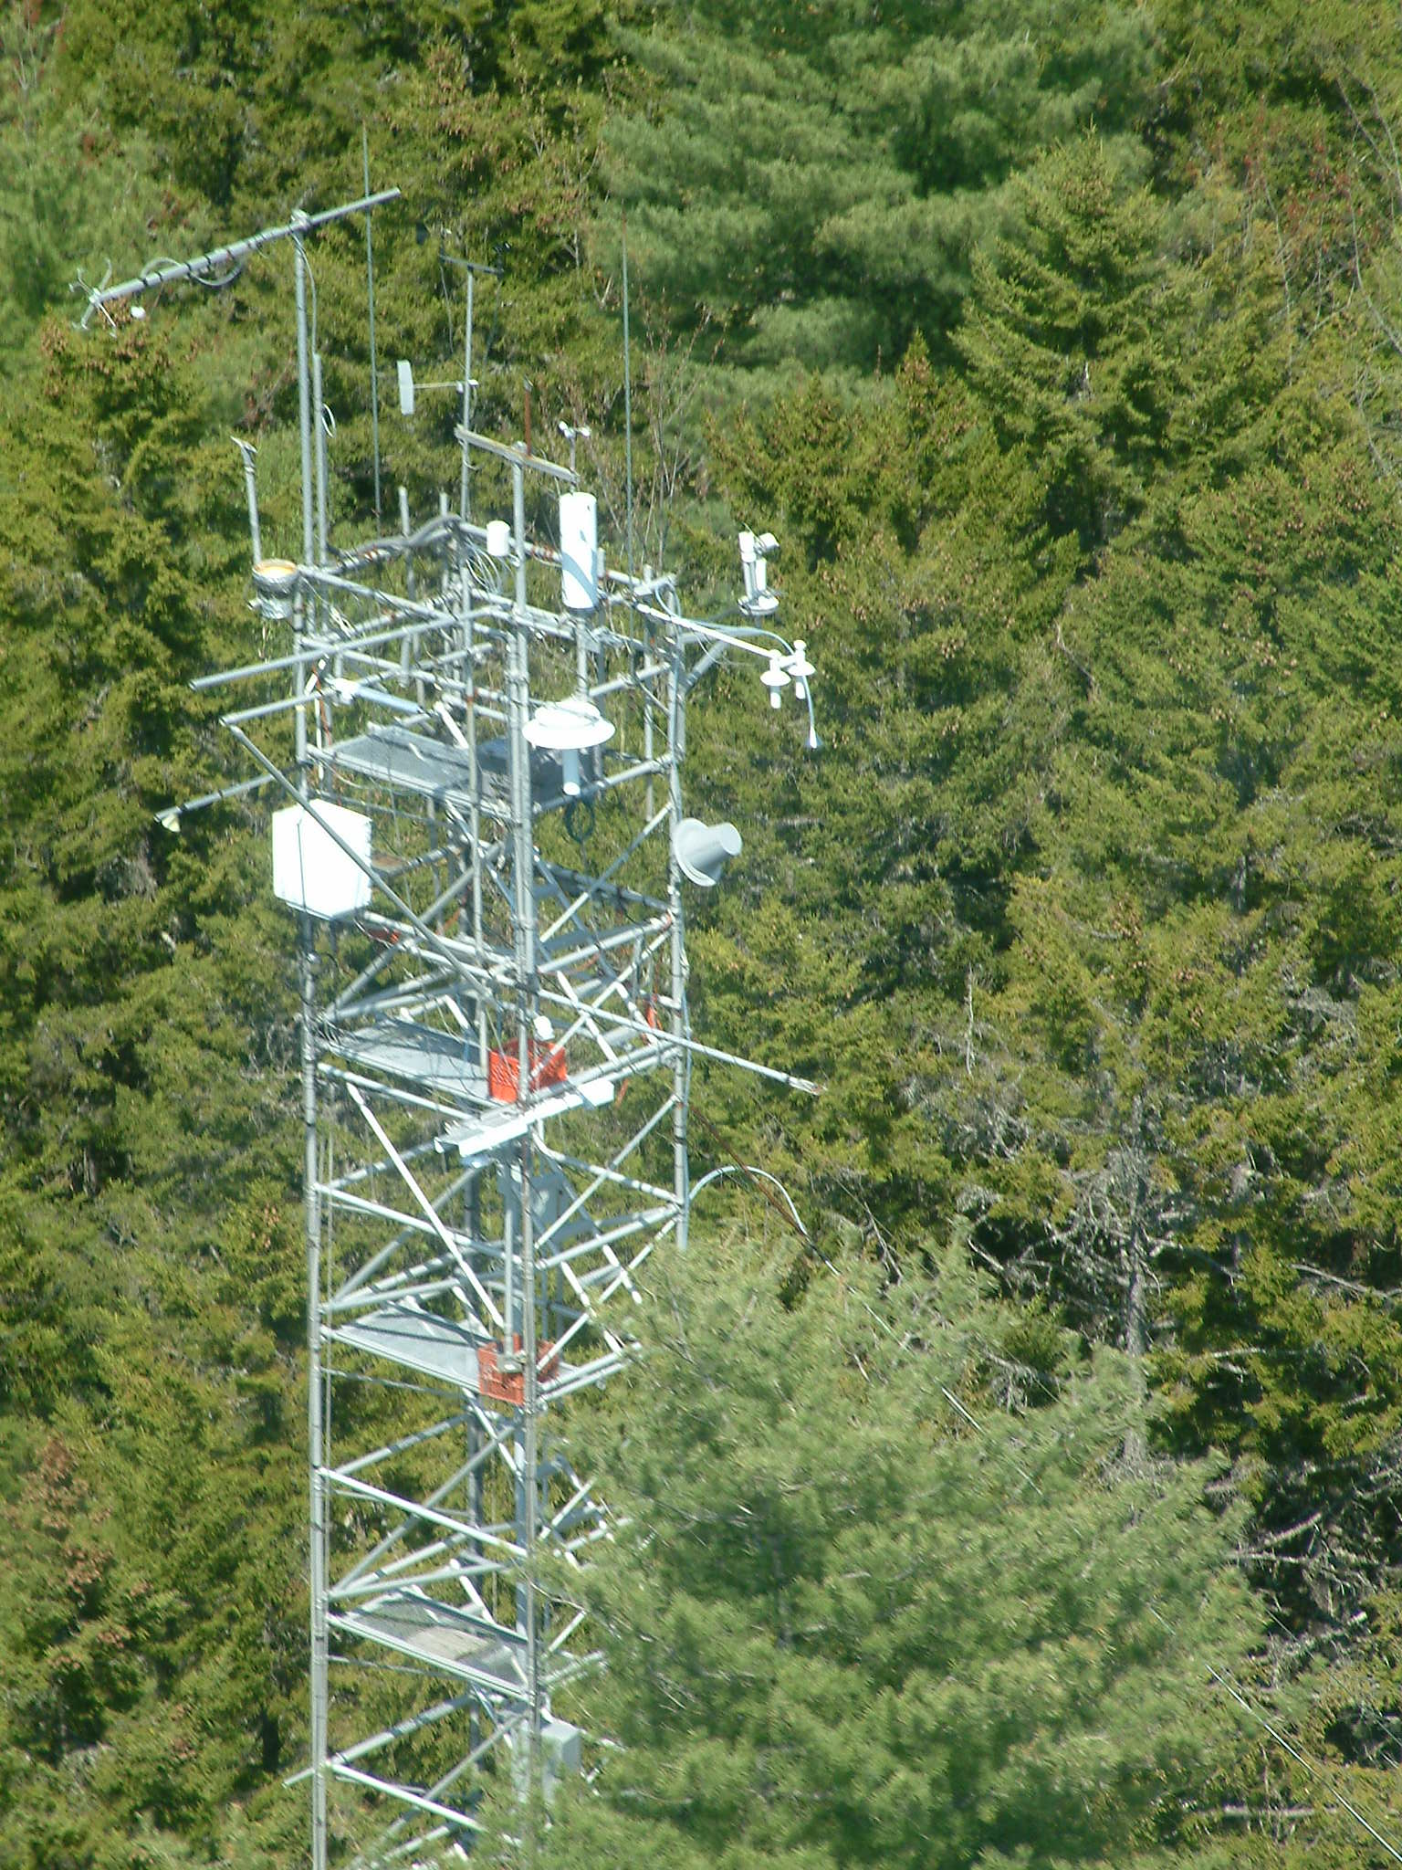
What we’ll do today
Run a CLASSIC simulation for a case study site on a DRAC high performance computer (HPC)
Boreal Mixedwood Forest
Selectively logged in 1930’s
Avg. forest age 85 to 90 years old
Eddy covariance tower location
AmeriFlux
Notes:
Eastern Ontario

Slide 45

What we’ll do today
Run a CLASSIC simulation for a case study site on a DRAC high performance computer (HPC)
Boreal Mixedwood Forest
Selectively logged in 1930’s
Avg. forest age 85 to 90 years old
Eddy covariance tower location
AmeriFlux
Notes:
Eastern Ontario

Slide 46
What we’ll do today
Run a CLASSIC simulation for a case study site on a DRAC high performance computer (HPC)
Boreal Mixedwood Forest
Selectively logged in 1930’s
Avg. forest age 85 to 90 years old
Eddy covariance tower location
Compare CLASSIC simulation to observed eddy covariance data
AmeriFlux
Notes:
Eastern Ontario

Slide 47
Using the Terminal

Slide 48
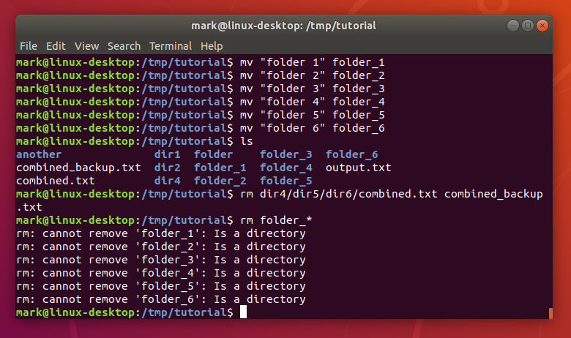
Canonical
Notes:
Perhaps you think of something like this when you hear the term the terminal…..

Slide 49
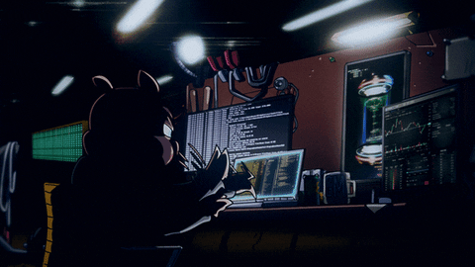
GIPHY
Notes:
….or maybe you picture a hacker in a dark lair.

Slide 50
Using a High Performance Computer (HPC)
In person
Notes:
Why it’s beneficial to learn how to use the terminal.

Slide 51


Using a High Performance Computer (HPC)
In person
Remote

Slide 52
Graphical User Interface
Notes:
What is a GUI?
A terminal lets you interact with a computer without a GUI

Slide 53
Terminology
Terminal: a text only input and output environment which allows you to control a computer

Slide 54
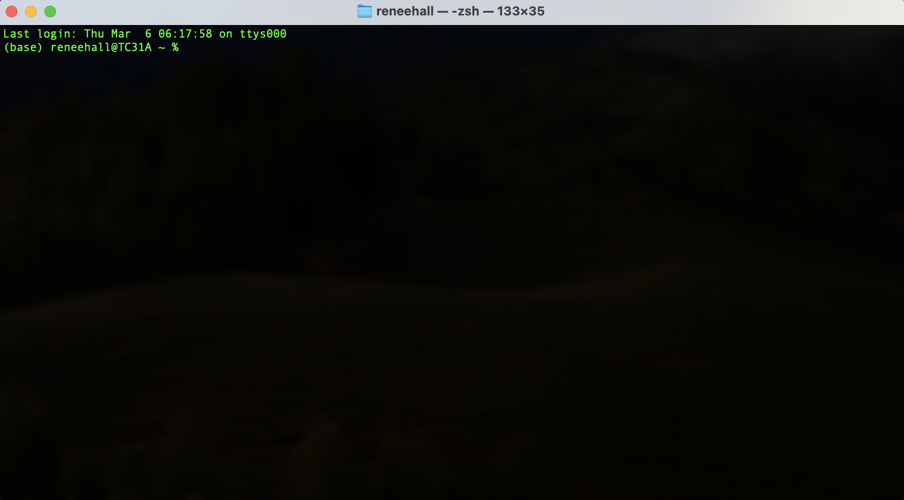
The Terminal

Slide 55
Terminology
Terminal: a text only input and output environment which allows you to control a computer
Command Line: Where the user types and executes a command

Slide 56
The Terminal

Slide 57
Terminology
Terminal: a text only input and output environment which allows you to control a computer
Command Line: Where the user types and executes a command
Shell: Processes the command and outputs the results
Bash: A type of shell and programming language

Slide 58
Terminal Activity

Slide 59
Bash Commands
pwd - print working directory

Slide 60
Bash Commands
pwd - print working directory
ls - list

Slide 61
Bash Commands
pwd – print working directory
ls – list
cd – change directory

Slide 62
Bash Commands
pwd – print working directory
ls – list
cd – change directory
mkdir – make directory

Slide 63
Bash Commands
pwd – print working directory
ls – list
cd – change directory
mkdir – make directory
touch – create new file

Slide 64
Activity
Using ONLY the command line:
Navigate to your user's Documents folder
Create a new directory called YourName_folder
In YourName_folder, create a new text file called YourName_file.txt
Bonus! If you finish all that and have time, using ONLY the command line:
Add the following text to YourName_file.txt, "Hello World!"
Delete YourName_file.txt
Hint: Google is your friend! There are a lot of great resources online. Don't be afraid to search for help.

Slide 65
Running CLASSIC on an HPC
Notes:
See speaker notes in submit_job_tutorial.ipynb Jupyter notebook for this activity.

Slide 66
Login to JupyterHub
https://jupyter.arc-for-eesc.c3.ca/

Slide 67
Environment Configuration
From the “Softwares” side bar menu
scipy-stack/2023b
mpi4py/3.1.4

Slide 68
Environment Configuration
From the “Softwares” side bar menu
scipy-stack/2023b
mpi4py/3.1.4
Install requirements in terminal
pip install -r /home/USER_NAME/projects/def-sponsor00/ARC_for_EESC/requirements.txt

Slide 69
Preparing to run our job
Create copies of files in your User folder
classic_submit_dra.sh
job_options.txt

Slide 70
Preparing to run our job
Create copies of files in your User folder
classic_submit_dra.sh
job_options.txt
Create sub-folder for CLASSIC output files
netcdf_files

Slide 71
Job Script
Open the classic_submit_dra.sh file

Slide 72
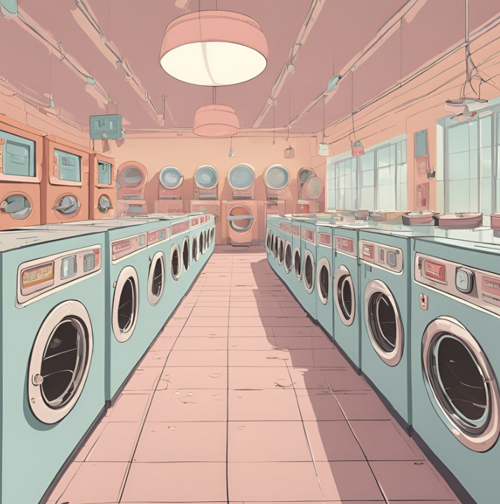

Slide 73
Job Script
Open the classic_submit_dra.sh file
On line 15, replace USER_NAME with the name of your user ex. user01

Slide 74
Job Script
Open the classic_submit_dra.sh file
On line 15, replace USER_NAME with the name of your user ex. user01
Open the job_options.txt file
On line 213, replace USER_NAME with the name of your user ex. user01

Slide 75

Thank-you!!
Ross Dickson with ACENET
Dr. Sian Kou-Giesbrecht
Lauren Gover
Carolina Natel de Moura
Lulwama Mulalu
The CLASSIC development team at Environment and Climate Change Canada

Slide 76

Exit Survey

